Slide 1

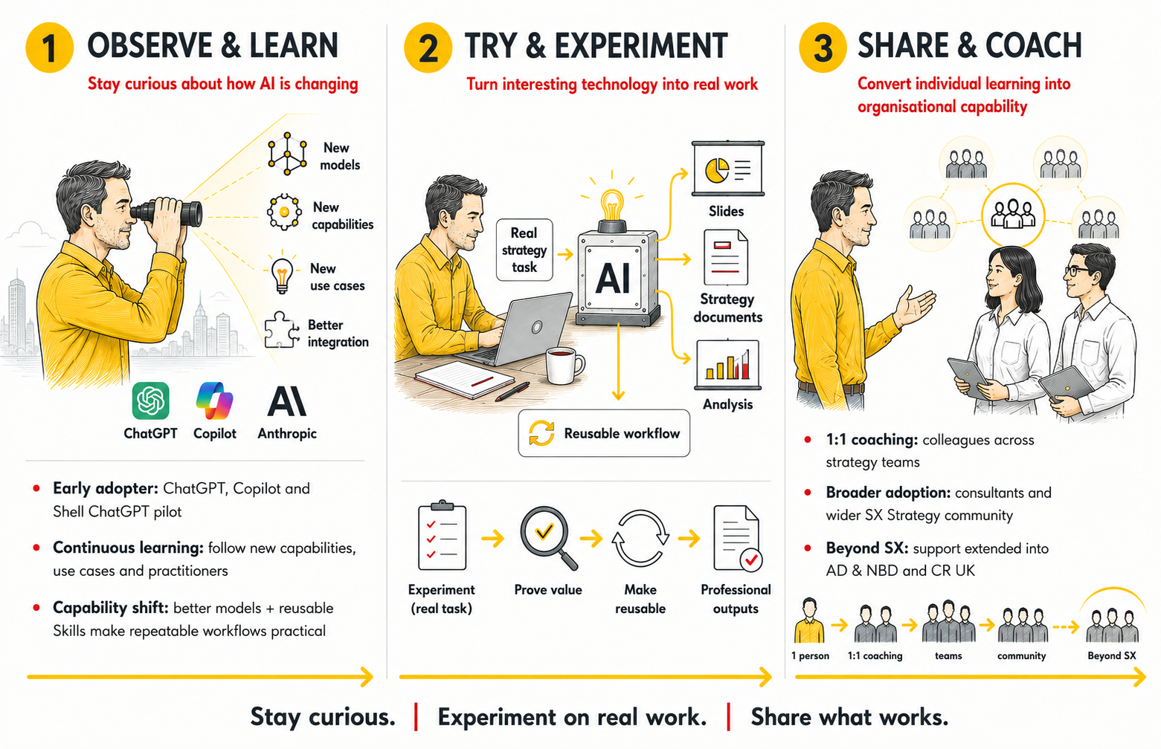
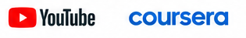
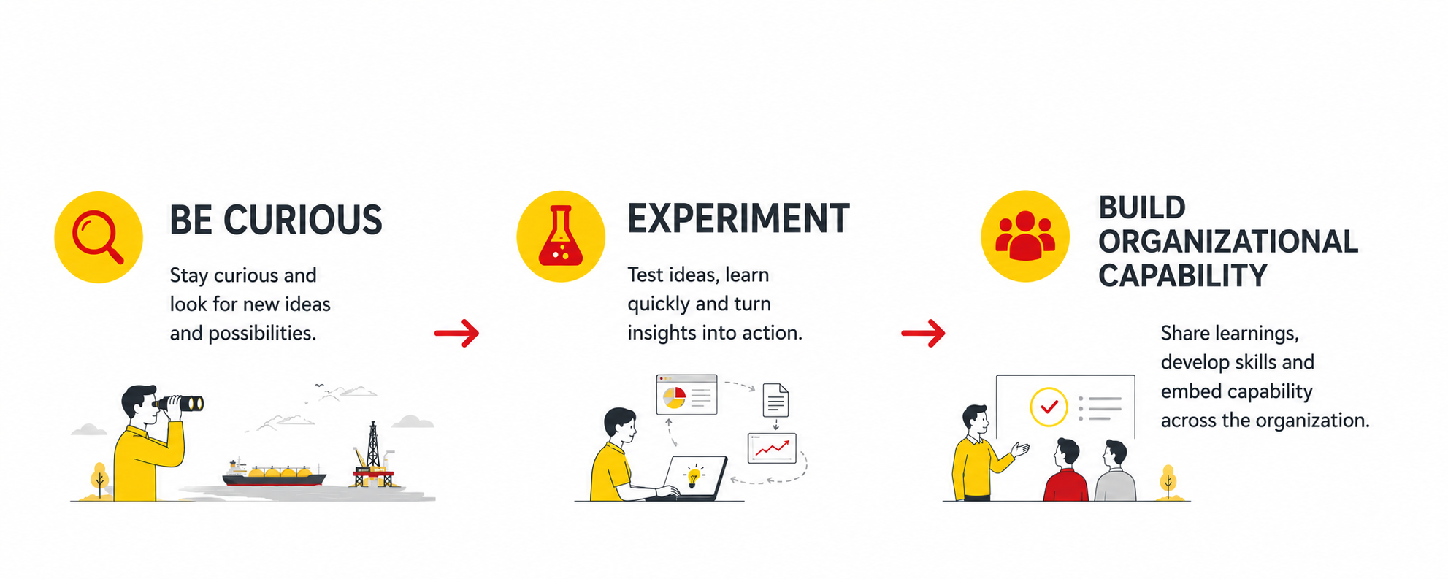
COLLABORATION & LEARNING
AI in SCA: Coaching the community on AI use
From individual curiosity & experimentation …
… to organizational AI capability
SHAPE
CONNECT
ACCELERATE
Ulf Nahrath, GM Corporate Strategy Downstream
SCA Global Team F2F 2026 | 7–8 September
MAIN CONTENT
1
OBSERVE & LEARN
2
TRY & EXPERIMENT
3
SHARE & COACH
Stay curious about how AI is changing
Turn interesting technology into real work
Convert individual learning into organizational capability
Early adopter: ChatGPT, Copilot and Shell ChatGPT pilot
Claude moment Q4 2025 – skills were used, ChatGPT 5.5. caught up w Claude Q2 2026
Learning: Coursera prompt trainings, YouTube videos
Start small: Test AI on real strategy work, doing slides (slide factory)
Build workflows: turn experiments into reusable Skills (skill factory, consulting skills)
Expand scope: Strategy Documents (ToR, NFI, OM, etc.), Illustrations
1:1 coaching
Consultants Training
Training x-strategy community (>80 people)
Other teams: AD & NBD and CR UK
ChatGPT Channel Teams >500 people
KEY LEARNINGS
BE CURIOUS
EXPERIMENT
BUILD CAPABILITY
Follow externally trends, think about improvement opportunities
Test ideas, learn and improve your workflows
Share learnings, develop and embed capability across the organization.
Shape. Connect. Accelerate.
September 7–8, 2026

